Slide 1
Safe Church Ministry
They will live in safety and no one will make them afraid --Ezekiel 34:28
Notes:
Safe Church is an important, valuable ministry, yet many do not know about it. People and churches need to know that Safe Church Ministry is available, that we are here as a resource to churches in abuse awareness, prevention and response.
We are always glad to have the opportunity to let more people know about Safe Church Ministry

Slide 2
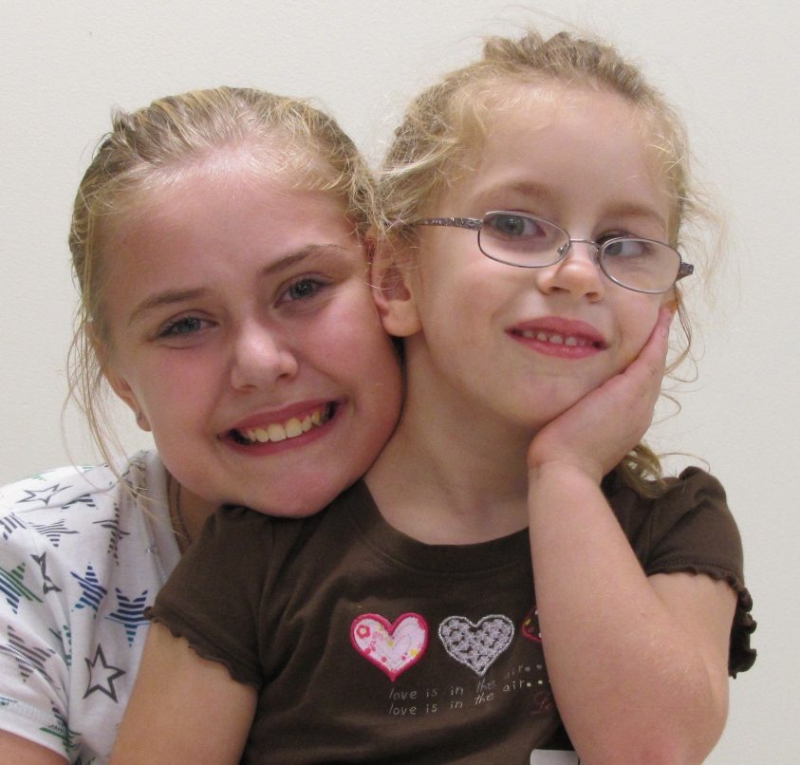
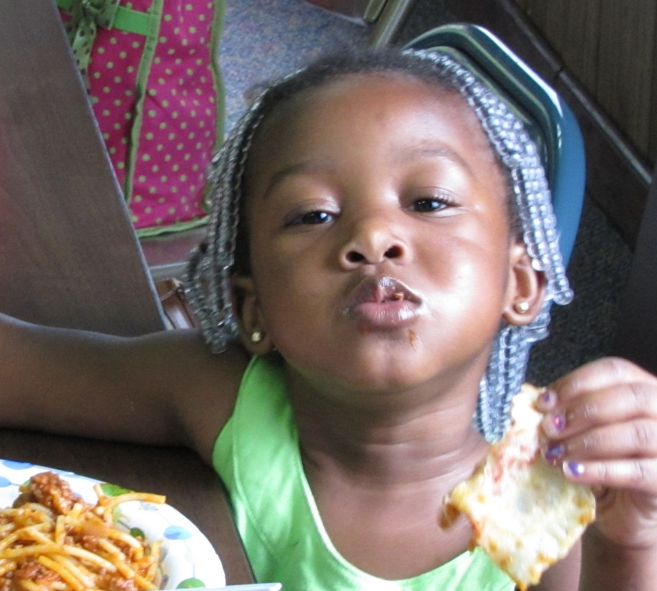
What Does Safe Church Ministry Do?
Abuse Prevention policies & education
Abuse Response In & outside the church
Notes:
Prevention – “an ounce of prevention, worth a pound of cure” never more true than in abuse situations. The devastation caused by abuse goes very deep, it’s long lasting and far reaching. Stopping it before it starts is the best strategy.
Response – can’t stop all of it, our response is a key factor in healing … huge potential for either help or harm in situations involving abuse – responding badly to an abuse situation can cause secondary wounding, which can be as hurtful as the initial pain caused by abuse. And even well-meaning, people can respond in ways that are unhelpful if they don’t recognize or understand abuse.
Safe Church Ministry Team Members are expected to promote awareness of Safe Church Ministry and Abuse issues – Every Pastor, church leader & church member needs to know that Safe Church is available as a resource to them.

Slide 3
Why Should My Church Care About Abuse?
It’s a Spiritual Thing
Our struggle is not against flesh and blood, but against the rulers, against the authorities, against the powers of this dark world and against the spiritual forces of evil in the heavenly realms.
-Ephesians 6:12
Notes:
The church is called to reflect our Lord and His kingdom. Abuse is contrary to the ways of our Lord, therefore we must be concerned when we find it in our churches.
It’s a spiritual issue – we must remember that we are discussing a topic in which the forces of darkness are fiercely fighting (and seemingly sometimes winning) against the light of our Lord and his kingdom. Other organizations can work to end abuse, but only the Church has the spiritual resources to combat it at its source.

Slide 4
Bible Beginnings
God created human beings in his own image, in the image of God he created them; male and female he created them. …
And God saw all that he had made, and it was very good.
Genesis 1:27 & 31
Humans, male and female, in God’s very image!
Notes:
In the beginning, before the Fall came and ruined everything… Men and women were together mandated to rule over creation, it was a partnership, they were naked and unashamed living with each other and with the Lord in a perfect world.
It didn’t last long – in Chapter 3 things fell apart. But the original beauty and dignity of creation still remains, even though it has been marred by sin. ALL people carry within them the image of their creator. ALL people are uniquely created with inherent dignity and infinite value. We are called to honor that, to love one another, care for one another, even the “least of these”.

Slide 5
It’s Contrary to God’s Way
“Do nothing out of selfish ambition or vain conceit. Rather, in humility value others above yourselves, not looking to your own interests but each of you to the interests of the others.” Philippians 2:3-4
It’s a question of power: power over others vs. power used in love and service to others
Notes:
A Question of Power
Abuse is all about power – even sexual abuse is much less about sex than having power and control over another person – sex is just an effective tool that’s used – Power used for selfish gain
The use of power in God’s Kingdom is opposite to the kingdoms of this world - Book “The Myth of a Christian Religion” by Gregory Boyd Power of Sword v. Power of God
Philippians 2 – Jesus is our example (gave up ultimate power, going to the cross)- Power used for love of others
Abuse in all its forms is about misuse of power – it is contrary to the way of the Lord – it must not be allowed to continue in our churches

Slide 6
We Are One Body
“From him the whole body, joined and held together by every supporting ligament, grows and builds itself up in love, as each part does its work.” Ephesians 4:16
When one member hurts, it affects the whole body.
Notes:
One Body
We are Christ’s Body – Image in Scripture, so rich and so powerful; and so counter-cultural to the individualism of our western society
One body says – we’re in this together – the parts are all connected, what affects one affects the other
Wounds need to be treated or they get worse
Ephesians verse “as each part…” we need each part; we need one another and need to care for one another

Slide 7
A Light to the World
“You are the light of the world. A city on a hill cannot be hidden… let your light shine before others, that they may see your good deeds and glorify your Father in heaven. Matthew 5:14-16
We are called to be set apart, as a witness to our Lord – Allowing abuse dims our light
Notes:
Salt and Light
Related to last slides – we are called to be a light to the world/different from it
In our culture where people are not valued, are used, disrespected, and abused; our churches need to be safe havens where people are treated with infinite value, dignity, and love
Note – Jesus valued children & women – So counter-cultural for his day – We follow him
Early Christians turned their world upside down because they understood that they were to look different from their surrounding culture – it was appealing, people flocked to these communities where they were cared for, valued, and loved – We need to learn this

Slide 8
Jesus Loves Children
“If anyone causes one of these little ones—those who believe in me—to stumble, it would be better for them if a large millstone were hung around their neck and they were drowned in the depths of the sea.” Matthew 18:6
We, who follow Jesus, must love and protect the precious children that have been entrusted to us.
Notes:
Matthew 18:1-6 – Read:
At that time the disciples came to Jesus and asked, “Who, then, is the greatest in the kingdom of heaven?”
² He called a little child, whom he placed among them. ³ And he said: “Truly I tell you, unless you change and become like little children, you will never enter the kingdom of heaven. ⁴ Therefore, whoever takes a humble place—becoming like this child—is the greatest in the kingdom of heaven. ⁵ And whoever welcomes one such child in my name welcomes me.
⁶ “If anyone causes one of these little ones—those who believe in me—to stumble, it would be better for them if a large millstone were hung around their neck and they were drowned in the depths of the sea.
Pretty harsh words! We need to protect children and those most vulnerable.

Slide 9
It’s Real & Has Real Impacts
Child abuse: A report every 10 seconds
Rape: 1 in 5 Women and 1 in 71 men
Intimate partner violence: 1 in 3 women and 1 in 4 men
Teen dating violence: 10% of high school students hurt in the past 12 months
Notes:
Besides what the Bible tells us, our churches need to care about abuse because it’s real and has real impacts – It IS affecting our churches whether we know it or not
Our churches are full of people who have been impacted by abuse. Stats taken from the US Dept of Justice report & National Intimate Partner and Sexual Violence Survey (Center for Disease Control) 2010
Studies show that the statistics are similar among those who regularly attend church.
Look out over your congregation next Sunday, think 1 in 5 or 1 in 4 or 1 in 10 teens – we’re talking about a LOT of people
Many kinds of Impacts: See next two slides

Slide 10
Impacts on Children
Remember: Jesus loves children!
Traumatology – Trauma & brain development
Cognitive delay: language development, intelligence, trouble in school …
Emotional impairment: attachment disorders, inability to form relationships, isolation …
Spiritual formation stunted: inability to believe that God is good or that they are loved
Notes:
Children are created and designed by God to be nurtured and cared for – not to be abused.
The effects of abuse on children is devastating. These same effects also show up when a child even witnesses abuse in the home; even if it does not involve them directly.
Chemicals are released into the brain during traumatic events that have various impacts over time; cognitive, social-emotional, and also spiritual.
Handout – Signs and Symptoms – school age

Slide 11
Impacts on Adults
Impacts can last a lifetime
Health Impacts:
obesity, gastro-intestinal problems, headaches, diabetes
Psychological Impacts:
depression, anxiety, low self-esteem, addictive behaviors
Spiritual Impacts:
inability to trust and form relationships, loss of faith & hope
Notes:
The impacts of abuse are long-lived and often go very deep
Those who have suffered abuse show a much higher incidence of all kinds of negative outcomes than the general population – there is a high correlation between these impacts and abuse experienced
So, even if abuse doesn’t happen in our church; it still has an impact in our churches. It affects all of us directly or indirectly. (remember, we are one body)

Slide 12
It Exists In Our Churches
Even when we don’t see it, it’s there!
I don’t know anyone…
Somewhere else, not here in the CRC …
Listen to the Voices …
Notes:
It Exists, even in our churches
Even when we don’t see it – know that it is there – You may think the stats are way out of bounds, you may say, “I don’t know anyone”. But you don’t know what you don’t know – you may not know that you know someone, it is a very hidden issue. (ask for show of hands, who knows someone)
Always a part of our training events in Safe Church ministry is small group discussion of situations or scenarios. The discussion of what factors enter into our opinions and decisions is always lively. Most situations are not black and white and there are usually many mitigating factors. Most of these situations are based on real-life situations that are faced in the CRC such as: (former sex offender in church; child on child abuse; youth leader in sexual relationship with 15 yr. old; pastor using pornography; etc …) It’s there, in our churches.

Slide 13
The Vision
Imagine…
In ALL Christian Reformed churches people are free to worship and grow in a safe place, free from any threat of abuse.
Relationships are open and honest; the value of ALL people is honored.
Where abuse has occurred, the church ALWAYS responds with compassionate justice that fosters healing.
Notes:
This is the vision that we want to keep before us – this is the vision that Safe Church Ministry is working toward
(read aloud slowly)
You, as a Safe Church Ministry Team Member, are the one expected to champion this vision. This means promoting awareness of Safe Church Ministry and Abuse issues (All the things that we’ve just covered) so that every Pastor, church leader & church member knows that in the CRC, we acknowledge the fact that abuse happens, that it affects our churches, and that Safe Church is available as a resource for prevention and response.

Slide 14
The Guiding Goals
Safe Church Top 5
Every church abides by a safe church policy
Every church uses a safe church curriculum for training children and youth
Every church follows approved protocols for responding to church leader misconduct
Issues of abuse can be freely discussed without shame
Leadership at all levels is committed to safe church ministry (support safe church teams)
Notes:
Gathering of Safe Church Team Chairpersons – 2011 – to brainstorm and envision – What is a truly safe church? (that’s where list came from)
Top 5 – Imagine what it would look like in your church
There is a lot of work to do; safe church is not primarily a reactionary ministry, ready to respond when abuse happens (although we want to be that too). Primarily we are a proactive ministry, promoting education, awareness and prevention as well as offering a healthy, effective response. We’d much rather work on the prevention side.
These are the goals that Safe Church Teams work toward, so that ALL our churches can be truly safe churches – It takes ALL of us to make a truly safe church

Slide 15
Prevention Strategy #1 - Policy
Policy must be developed
Input from key stakeholders
Uniquely fits church situation and programs
Policy must be followed
Screening – application, interview, time at church, references, criminal background check
Supervision and accountability
Policy must be maintained
Regular review – committee, legal, insurance
Annual training
Notes:
Policy development – not easy or quick but well worth the effort.
No one policy will work for every church
The process of developing a policy, thinking together about what will make your church a safe place, is very valuable.
Policy followed – it is not helpful to have a policy tucked away somewhere that no one knows about
A simple policy that can be followed is best
Legal liability comes into play most often when there is negligence in screening and in supervision
(Overview – Separate Presentation on Policy)

Slide 16
Community 4%
Stranger/Other 3%
Church 4%
Abuse at Home 85%
School 4%
According to survey by Calvin College Social Research Center – Abuse in the CRC – Published 1992
Notes:
Where does abuse occur?
Though we maintain a Safe Church with protective policies we are only dealing with a very small percentage of abuse.
What is the responsibility of the church in light of this graphic?
Stranger/Danger is mostly a myth – most abuse happens at home!
Because of the severe impacts of abuse and how it affects the church body and community, we need to be concerned with abuse no matter where it occurs.

Slide 17
Prevention Strategy #2 – Education & Awareness
Circle of Grace
A program that equips children and youth to participate in a safe environment for themselves and others.
Notes:
Circle of Grace – A Safe Environment Program
Circle of Grace: A holistic approach
Key concepts include:
God’s presence with us at all times
The value and sacredness of each person
Tools to identify safe and unsafe situations
Learning to respond to unsafe situations with help from a trusted adult
Also includes training resources for teachers and information for parents – a comprehensive program
(Handout Brochure & preview packet)

Slide 18
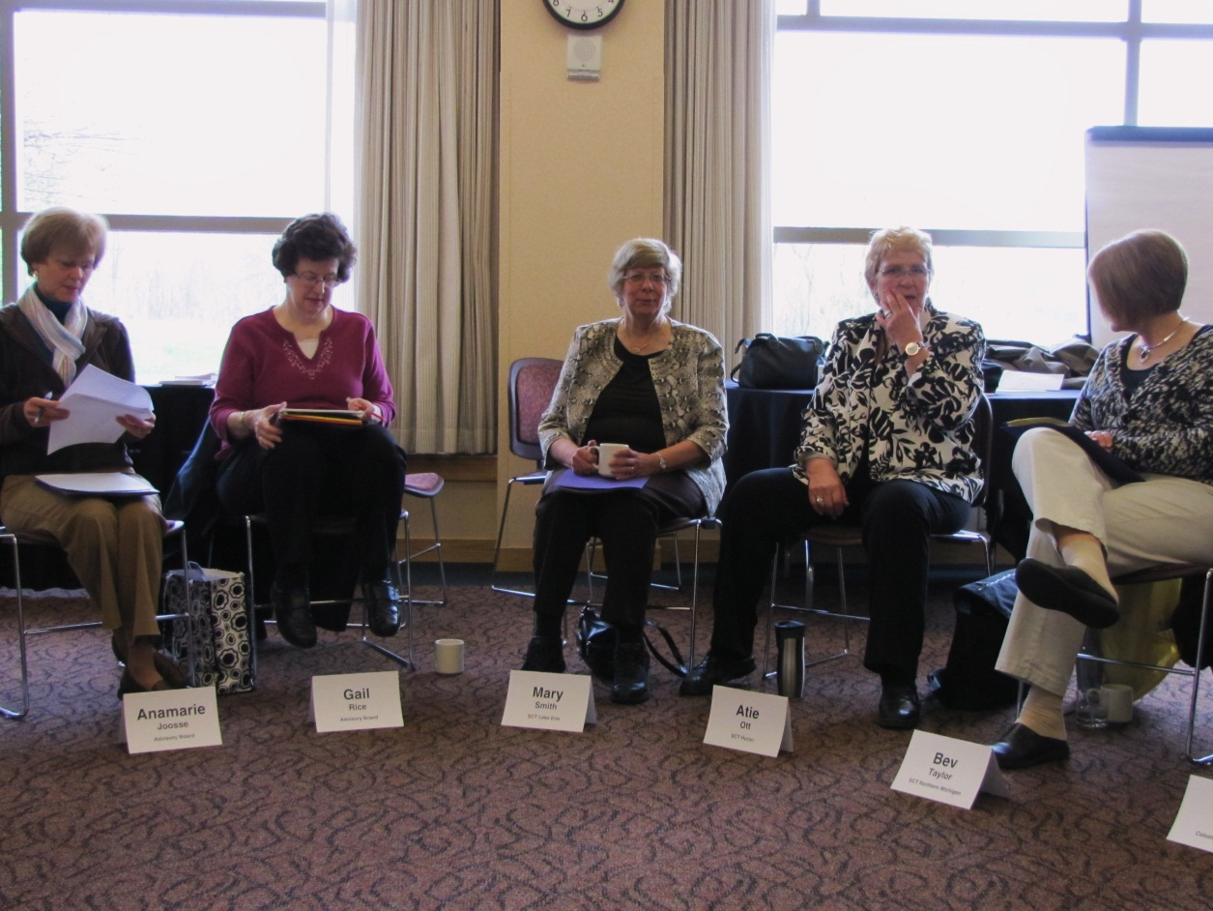
Structure Supports Vision
Each Classis or Region: A safe church team
Each Team: A safe church rep from each church
Each Church: A safe church committee
Notes:
It can’t all come from an office in GR – Can’t know all the local resources, or state & provincial laws – Can’t travel everywhere to do all the education that’s needed in churches – Ideal, each classis, each church
Classis or region – sometimes two or more classes come together to form one team
Safe Church classis or regional Teams – trained – gifted and skilled (therapists, social workers, ministry leaders, lawyers, educators, anyone really) – A valuable resource for churches – Meet 1-3 times /year
Safe Church local church committee – to make sure that there is an effective policy; to coordinate efforts at the local church level (curriculum, training, local resources, etc…)

Slide 19
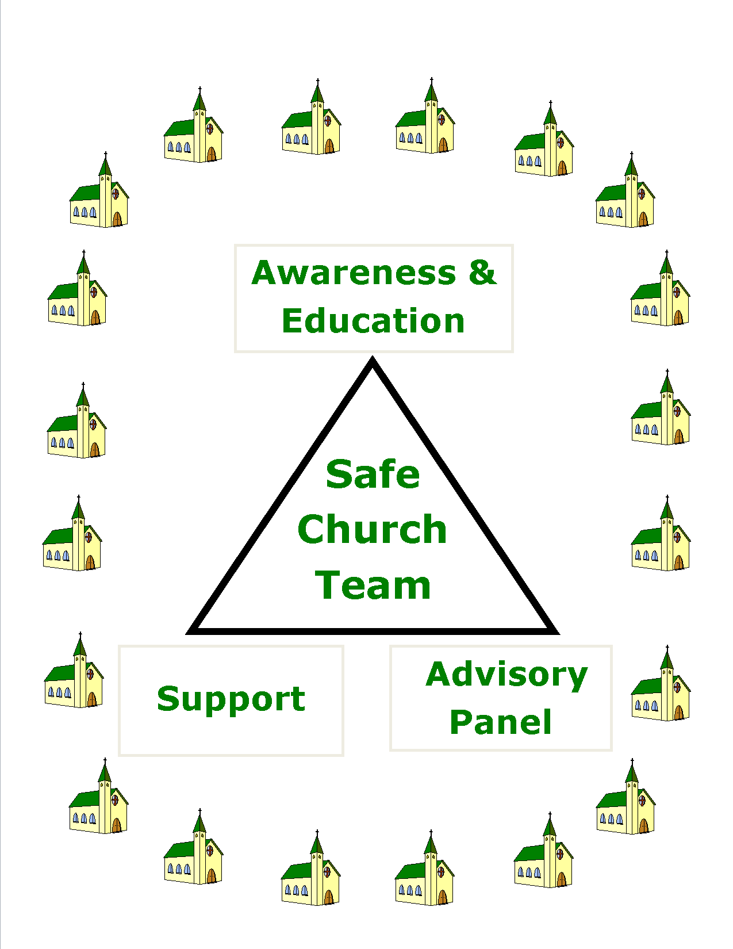
Safe
Church Team
Mandates
Notes:
For the more visual people among us – here is a picture
Safe Church Ministry depends on classis or regional Safe Church teams – The team serves the churches, not everyone on the team has the same role, or same gifts and skills, but together they serve all the churches in their service area
Three mandates – all are needed, they complement each other – three legged stool
Imagine this multiplied all over Canada & US

Slide 20
#1. Education & Awareness
Abuse Awareness –
4th Sunday in September
Different topics for different years:
2012 – Internet Pornography
Notes:
Let’s take a closer look at the three mandates. The first is Education & Awareness.
It’s the best prevention – teams provide learning opportunities that increase awareness through programs for all ages on various abuse related topics; they promote use of curriculum for children and youth such as “Circle of Grace”, “Safe Keeping” & “Driver’s Training for Dating”, they provide leadership in policy development and training; etc.
The other mandates will not work without a basic awareness

Slide 21
#2. Support
Specialized support for churches & individuals
Confidential conversations, safe church advocate, a listening ear, policy help, etc…
Notes:
Pastors are expected to know everything about everything – they can’t know everything
Having a trained Safe Church Team to go to when questions and situations arise can be an invaluable resource
Partnering w/community resources: Church’s role in difficult situations is to “walk-alongside” Safe Church training does not make us counselors, social workers or experts. It does help people respond with greater understanding and be able to refer to local resources
The value of a listening ear cannot be overestimated!!!

Slide 22
#3 Advisory Panel Process
For responding to allegations of abuse by a CRC church leader
Both sides present to a trained panel
Panel reports to church council
Council determines the appropriate response
Important safeguards for all parties
Notes:
The APP can be used when an adult brings an allegation of abuse against a CRC church leader
There is no statute of limitations in this process –even if the incident occurred when the claimant was a child
The process includes important safeguards for everyone involved – puts the process in a more neutral, unbiased place – takes pressure off council & provides safety for the claimant.
A step-by-step user-friendly guidebook is available for church councils so that they understand their role in the process
Churches fail to use this process at their own peril! (I’ve seen devastation that could have been avoided by using this process)

Slide 23
A Restorative Word
When the Advisory Panel Process doesn’t fit, or after an Advisory Panel – Restorative Practices may be used
Synod 2005 – Report on Restorative Justice
Synod 2010 - Abuse Victims Task Force Report
Restorative Justice practices:
Accountability, restitution, righting wrongs, healing broken relationships
Notes:
For situations that don’t fit the Advisory Panel Process: A Restorative Process may be considered:
Beyond blame and punishment to restoration of community – not adversarial, but communal – we are one body – it’s about restoring relationship
It isn’t just “making nice” – It gives the victim a voice, and takes an honest look at the harm done and the impact
We’re often too quick to forgive – Restorative processes encourage taking responsibility for harm done and making amends and restitution for losses as much as possible
Power differential in abuse situations requires specially trained facilitators – Helpful in giving victims a voice and involving a community that can give support

Slide 24
Safe Church Ministry A Resource for YOU
Website – www.crcna.org/safechurch
Director – bnicholas@crcna.org 616-224-0735
Classis and Regional Safe Church resources
Notes:
Safe Church is here for to be a resource to you
We can strategize together about ways to move Safe Church Ministry forward
Really, don’t hesitate to contact Safe Church Ministry – Bonnie or Alicia
Website – an excellent resource! Constantly being updated – refer to it regularly

Slide 25
Notes:
It takes all of us to be a truly safe church
This picture – Conference in April 2012 (over 70 Classis Safe Church Team members in attendance)
Importance of making connections so none of us feel that we are doing this work alone – learn from one another, encourage one another, an invaluable time together.
Training conferences are hosted by Safe Church every other year. In the alternate years, classes and regions host their own more local training events. Important for Safe Church Teams to be active and engaged, to learn new skills and information, and to be the best possible resource for churches.
We always need more people involved in Safe Church Ministry – It takes the whole church to be a safe church

